Slide 1
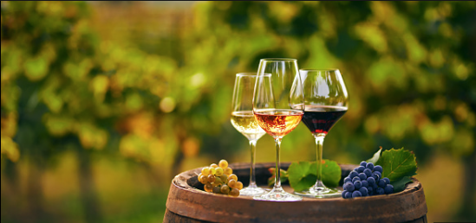

Spanish Wine Evaluations
Predicting the wine ratings based on prices, body, and acidity.
By: Paul Montecinos

Slide 2
Spanish Wineries
Vineyards across Spain
Determining what qualities of wines receive the best ratings
Characteristics
Red
White
Sparkling
Body/Acidity

Slide 3
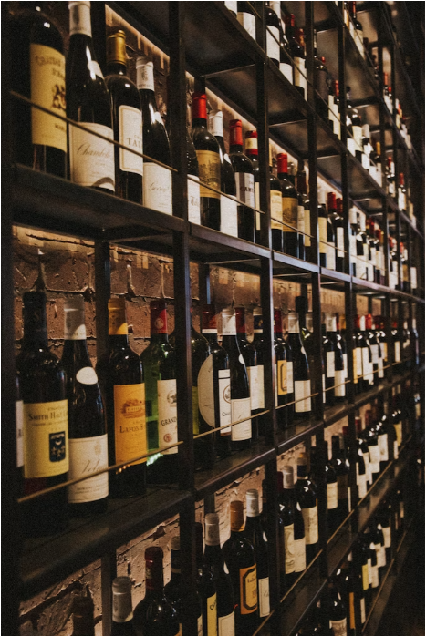
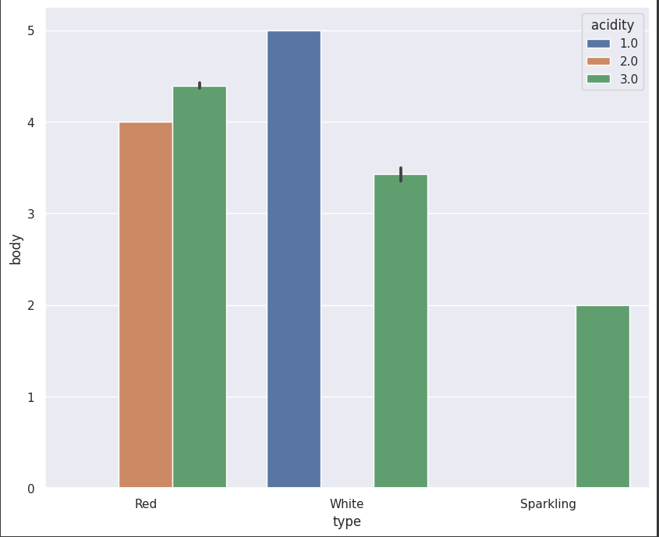
Acidity
crispness and drinkability.

Slide 4
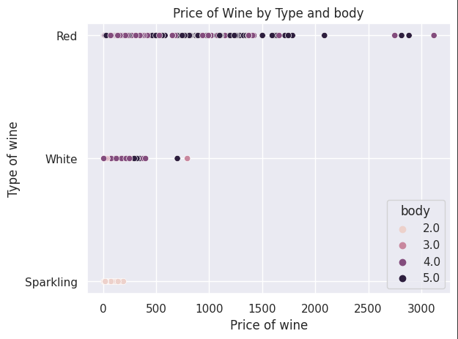
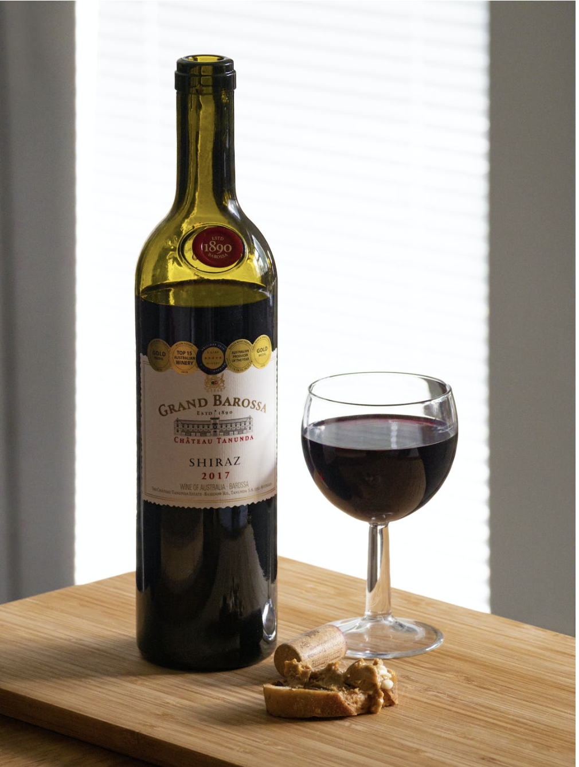
Body
Mouthfeel and weight on your palette.

Slide 5
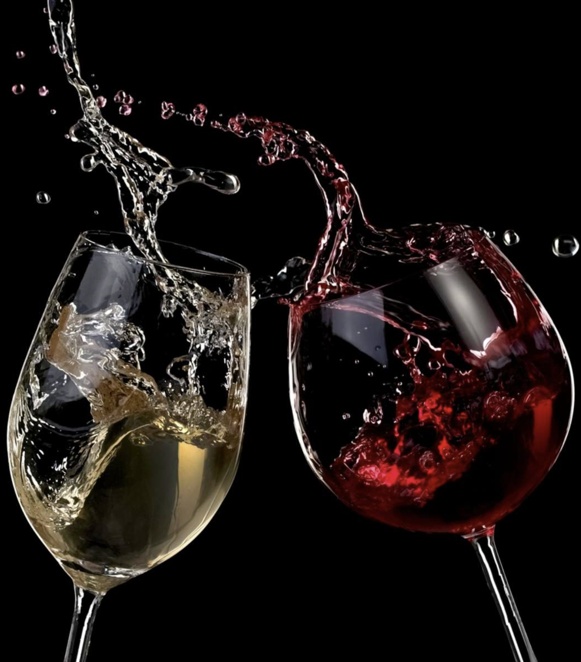
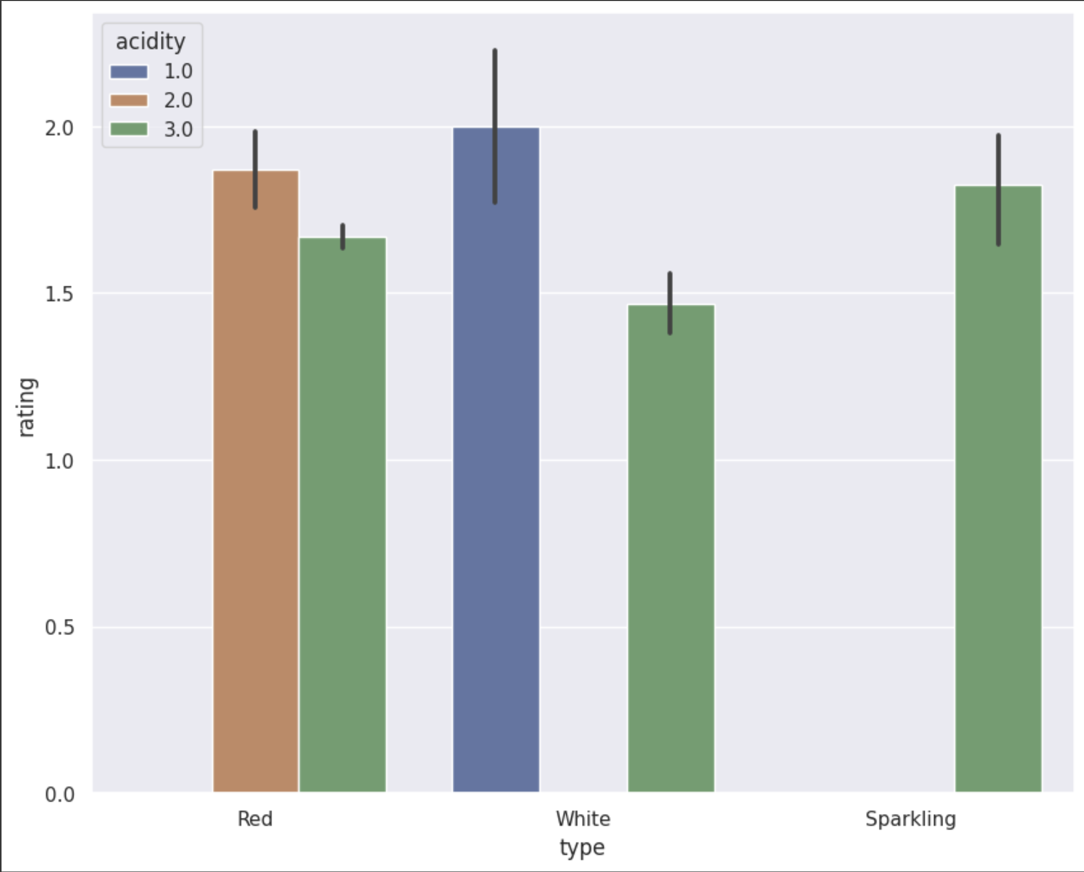
Ratings
Ratings 0 – 2, 2 being the best.

Slide 6
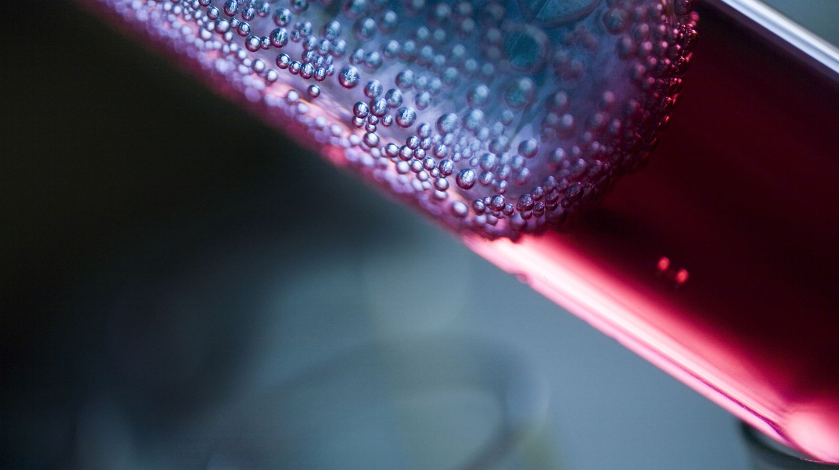
Conclusions & Recommendations

Slide 7
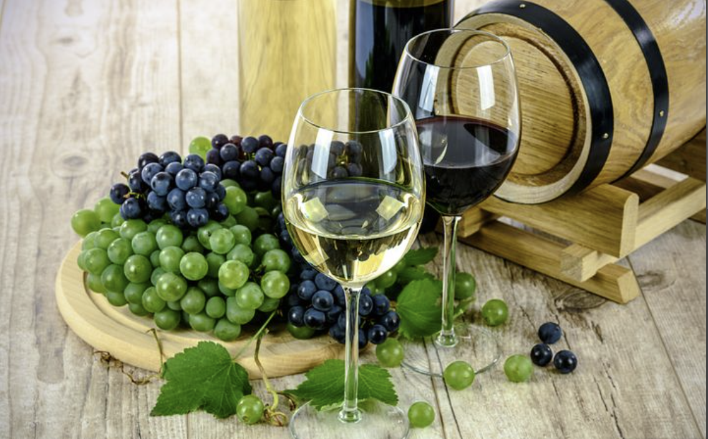
Wine Type | Percentage
Red | 82.91%
White | 14.65%
Sparkling | 2.44%
White and red wines lead the pack when it comes to ratings.
The higher body generally leads to better ratings.
I would recommend we produce more full-bodied wines
We can also market our lower rated wines as everyday drinking wines
Potentially market certain wines during certain season
Lower ranked acidity levels would sell at a higher rate in summer months
Higher bodied wines would sell better in the colder months
Produce more white wines with fuller body profiles, since they received the highest ratings

